Slide 1
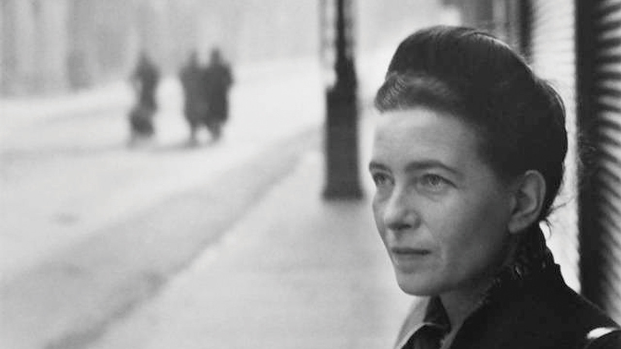
Simone de Beauvoir
14 April 2020
GENTRAIN
MONTEREY PENINSULA COLLEGE
STEPHANIE SPOTO

Slide 2
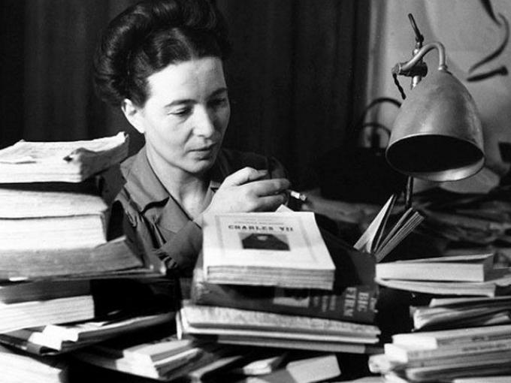
Simone de Beauvoir: philosopher 1908-1986
Simone de Beauvoir has only gradually won the right to be recognized as a philosopher (identified as an author rather than a philosopher – called herself the “midwife” of Sartre’s existential ethics)
However, her place in philosophy is now uncontested
Especially after feminist philosopher, Julia Kristeva, organized a conference celebrating the centennial of Beauvoir’s birth
Made enduring contributions to existentialism, feminist theory, ethics, politics and feminist theory (unlike her status as a philosopher, her status as a feminist theorist has never been questioned)
Most known for The Second Sex (1949) → controversial from its first publication
English translations were abridged until the 2010 English translation
Original English translation was done by a zoologist who didn’t understand the nuanced philosophical implications of her language.
2010 translation provided the full text with greater attention to her philosophical language

Slide 3
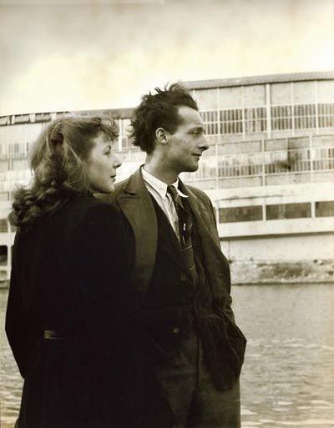
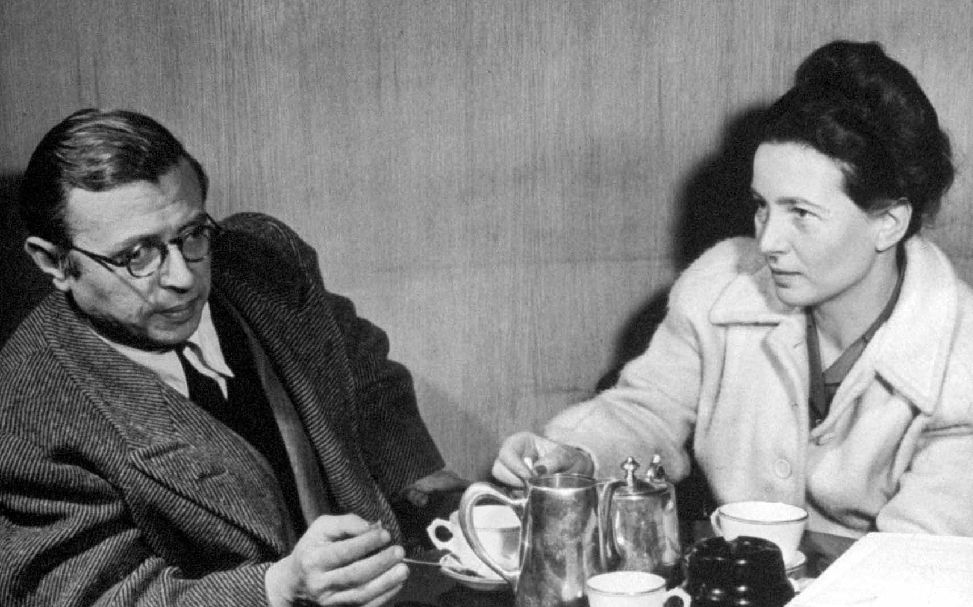
Life and education meeting the existentialists
Born 1908 in Paris to bourgeois Parisian family (lost much of their fortune after WWI)
Along with younger sister, Hélène, she attended a prestigious convent school
Though she was religious as a child (and at one point wanted to become a nun) she became an atheist as a teenager
Attended the same secondary school as other important thinkers of her time, such as Maurice Merleau-Ponty and Claude Lévi-Strauss
Though she was not officially enrolled, she sat in on courses at the École Normale Supérieure to help prepare her for the philosophy aggregation
While studying for the exam she met other students, including Jean-Paul Sartre who would become her lifelong partner
The judges for the exam narrowly awarded Sartre with first place over Beauvoir (who received second place)
At the age of 21 Simone de Beauvoir was the youngest person ever to pass the exam.
Simone de Beauvoir & Maurice Merleau-Ponty (1908-1961), 1930

Slide 4
Literature and the Metaphysical Essay (1946)
In this essay, Beauvoir outlines her critique of the philosophical status quo → also outlines her method of doing philosophy in literature
Existentialist approach influenced by Heidegger and Husserl → focuses on the importance of lived experience and how language reveals meaning in the world
In making this revelation, Heidegger looks to poetry
Beauvoir (together with Camus and Sartre) look to the novel and the theater
The existentialists turn towards Husserl to create the theory that supported this turn to these discourses
The turned towards Heidegger to critique the privileged position of abstract investigations/philosophy
All theoretical analysis must be grounded on the concrete reality of lived experience
Above and beyond the others, Beauvoir theorized about this turn to literature
It carried political, ethical and philosophical implications
Examines the limits of the appeal (calling on others to take on her political projects)
Displaying/depicting/exploring the temptation of violence
Explore and enact the ethics of existentialism: freedom, joy, generosity, responsibility
Allows for the closer contact and examination human relationships in their intimacy and complexity

Slide 5
The Second Sex
Challenge to philosophical status quo was part of the larger philosophical project taken up by her, Sartre, and Camus
Her challenge to the patriarchal status quo was more intense and dramatic
Though first regarded more as an insult to sexual propriety (and not a political attack on patriarchy or a phenomenological philosophical examination of being “woman”)
Wasn’t until the second wave feminist movement (1960s) that the deeper implications of Beauvoir’s work were recognized
Expressed a sense of injustice which resonated with the second wave feminist movement
Helped alert them to the connections between public policies and private practices
Is still a controversial book (though no longer for being sexually scandalous) → Beauvoir’s critique of patriarchy and her proposed solutions are still debated

Slide 6
The Second Sex Equality and Sameness
The Second Sex introduced the gendered/sexed body as an object of phenomenological and philosophical analysis
Her argument against patriarchy and in support of equality had to strains:
Critiques masculine ideology and its exploitation of sexual difference in order to systematize gender inequality
Shines a light on the ways that calls of equality run the risk of erasing difference → this establishes the masculine subject as the “neutral” and absolute human type.
Focuses on Plato for this strain: Plato claims that sex is by chance or accident and both women and men are able to be part of the guardian class. If women want to be part of this privileged class, they must live and act like men.
Therefore, discrimination remains: only men or those who mold themselves as men and emulate men may rule
Beauvoir’s philosophical argument does not fall into this trap: women and men must treat each other as equals → this treatment requires that sexual differences be acknowledged, honored, and validated.
Equality does not equal sameness.

Slide 7
The Second Sex Phenomenology and acknowledging difference
Argues against what Beauvoir sees as a false dichotomy: either the genders are equal or they are different
Argues that women are equal to men, while still acknowledging sexual difference → unjust and immoral to argue for women’s subordination based on this difference
However, it is un-phenomenological to dismiss it → as a phenomenologist, Beauvoir’s challenge is to analyze women’s particular embodied experiences – also how are these experiences determined by our “everyday attitude”?
“everyday attitude”: these are the assumptions we make based on “common sense” that we uncritically bring to our experiences
Common sense and cultural assumptions filter and frame women’s experiences of their own bodies → for example, women are called “the weaker sex”, but what is this assertion based on? Upper body strength? Size? But isn’t longevity a form of strength?
The set of criteria used to judge and assert the supposedly self-evident fact of women’s weakness → she then transforms it from an unquestionable fact to a biased and unreliable assumption

Slide 8
The Second Sex Distinction between sex and gender
“One is not born but becomes a woman” → credited with pointing out the distinction between sex and gender
This is a statement which could have incredibly radical implications, and though it is still being studied and explored, most feminists, sociologists, and philosophers now ascribe to its meaning: gender is not something that someone is born into, but something that one developed into through social conditioning.
Important background to transgender theory
The Second Sex gave us the language for examining the social constructions of gender and then it gave us a method to for challenging these social constructions.
Beauvoir does not accept the “everyday attitude” or common sense idea which accepts that it is automatically true that anyone born with “female” genitalia is born a woman → here she takes on a foundational rule of phenomenology:
Search out and identify any assumptions and put them aside as biases or based on social conditioning. Only incorporate them into your analysis if experience validates them.

Slide 9
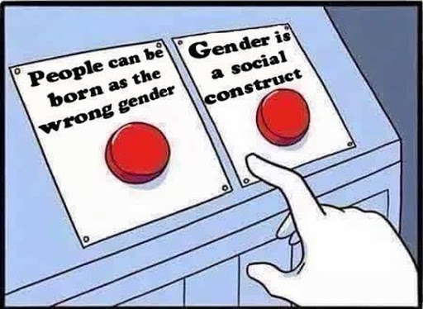
Contentions in Trans Theory Fighting to be recognized as your true gender
Helpful key terms:
Transgender: does not identify with the gender they were assigned at birth
Cisgender: does identify with the gender they were assigned at birth
Beauvoir claims that one is not born a woman, but becomes one through social conditioning.
Though transgender theorists and advocates might agree that there should not be a legally or socially binding link between genitalia and gender, some might take issue with some of Beauvoir’s claims:
If gender is a social construction, then there is no reason why a person shouldn’t be able to identify with any gender they want to → even changing their gender identity several times or not identifying with any gender.
However, many trans people don’t believe that gender is a social construct → for them transitioning is a battle to be fought with how they feel “inside”. For some, their bodies are a barrier to being recognized as their true selves, a true self that is not a social construction, but a deeply felt and real gender

Slide 10
Woman as Other the evolution of Hegel’s Master-Slave dialectic
Hegel: Master & Slave
Beauvoir: Subject & Other Master=Subject (absolute) Slave=Other (inessential)
Hegel’s Master-Slave dialectic is universalized, but Beauvoir’s dialectic is specific to the exploitation of Subject and Others when the Subject is Man and the Other is Woman.
Hegel’s dialectic: the slave (Other) experiences communal reality of their oppression as an oppressed group. They can call on history and their shared situation to proclaim their Subjectivity and demand recognition.
Beauvoir’s dialectic:
Similarities: Men (like the Hegelian ‘Master’) identify as the Subject, the neutral human type, and then measure women against this constructed standard, of course finding them deficient. These deficiencies are used to justify their position as Other.
Differences: Women are not able to identify the origins of their alienation. No shared history to help them reclaim their position in society as Subjects. Since they are dispersed among men and the world built on their terms, they often identify themselves in these same terms. They lack the solidarity of the Hegelian Slave for organizing themselves. Therefore, women’s path to liberation cannot follow the same path as the Hegelian Slave.

Slide 11
The Second Sex Requirements for liberation
The last part of The Second Sex (“The Independent Woman” and the “Conclusion”) explore the status of the situation of women in the 1940s → what has changed and what still needs to be different.
Points to women’s suffrage and new moves towards economic independence, but claims these are liberal and Marxist solutions that are not enough → ignores the impact of gendered socialization and how men and masculinity remain the subject and privileged position and the neutral or standard of humanity.
The free/liberated woman has to throw off two sets of chains:
Abandon the notion that if she wants to be independent then she must emulate men (alienates her from her sexuality)
Must also throw off the chains of the socialization that framed her feminization (discourages risking herself for her ideals)
Paying attention to the body, two things must happen for liberation:
Socialization must change: women must be socialized to participate in and engage with the world
Uncover the particular and unique ways that their embodiment interacts with the world.
Must dismantle the pervasive myths about woman, which hinder the goal of liberation, but to deconstruct this myth is not to move towards a necessarily androgynous future → claims that differences in embodiment will continue to lead to differences in gender, but these differences will no longer be grounds for oppression and the construction of the Subject and Other

Slide 12
Sources & Resources
Bergoffen, Debra and Burke, Megan, "Simone de Beauvoir", The Stanford Encyclopedia of Philosophy (Summer 2020 Edition), Edward N. Zalta (ed.), forthcoming URL =
< https://plato.stanford.edu/archives/sum2020/entries/beauvoir/ >.
de Beauvoir, Simone. “Introduction,” The Second Sex. Trans. H.M. Parshley. New York: Knopf, 1976.

